Slide 1



Model-assisted Method for Damage Severity Assessment in Honeycomb Sandwich Panel
Piotr Fiborek, Paweł Kudela
Institute of Fluid Flow Machinery,
Polish Academy of Science
Notes:
Thank you, Mr Chairman. Good evening everyone. I represent Mechanics of Intelligent Structures Department at the Institute of Fluid Flow Machinery. Today, I am delighted to share our latest research on the numerical modeling of the phenomenon of elastic wave propagation in sandwich panels. The developed model was used to determine the size of damage in the panel.

Slide 2
Table of contents
Introduction
Development of the HSP model
Experimental validation of the model
Model-assisted damage identification function
Final remarks
Notes:
Here is the outline of my presentation. I will begin with a brief introduction to the subject to set the context for our research.
Next, I will describe the model we used in our research. I will explain the basic principles and assumptions of the model.
This will provide a solid foundation for understanding the methodology we used.
Moving on, I will describe the process we followed to validate the experimentally obtained model. I will explain the experimental setup we used and discuss the comparison between the model predictions and the actual experimental results. This validation step is crucial in ensuring the accuracy and reliability of our findings.
Following that, I will present a novel method for determining the function that governs the effect of damage size on the propagation of elastic waves. This method, based on computer simulations, allows us to gain valuable insights into the relationship between damage size and wave propagation characteristics. I will then compare the functions obtained from these simulations with the experimental results, highlighting any significant agreements or disparities.
Finally, I will conclude the presentation by summarizing the key points we have discussed throughout. I will emphasize the contributions and implications of our research, as well as potential future directions.

Slide 3
Introduction

Slide 4
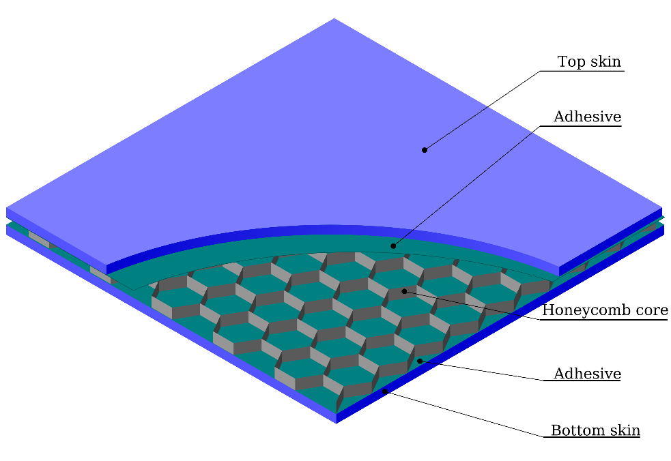
Sandwich composite structures
Multi-layered structure composed of a mid-core and thin skins
High strength-to-density ratio
High acoustic or fire insulation properties
Notes:
"Sandwich panels, composed of two outer layers and a core material in between, are widely used in various industries due to their lightweight yet high-strength properties. Different materials are used for both the skin panels and the core of the panel. Additionally, various forms of core are employed to reduce the weight of the entire structure, such as honeycomb or foam cores."

Slide 5
Aim of the research
Aim
Investigation of guided waves (GW) propagation in honeycomb sandwich panel (HSP) using numerical simulations
Motivation
Assessment of the damage severity in HSP by model-assisted damage identification function (MADIF)
Notes:
The propagation of elastic waves in Honeycomb Sandwich Panels (HSPs) is a complex phenomenon influenced by their unique construction. Gaining a better understanding of how waves propagate through these panels is crucial for developing effective tools for structural health monitoring. Our motivation is to develop a function that accurately describes the effect of damage size on the characteristic parameters of the propagating wave."

Slide 6
Challenges in modelling of the GW in HSP
Challenges
complex mesh of the honeycomb core large number of DOF due to the complexity of the core large time and memory consuming
Most common modeling approaches | Present modelling approach
homogenization of the honeycomb core reduction of the sample dimensions simplified model to two-dimensional omission of an adhesive layer lack of the transducers | use of fast-convergence numerical methods parallel computation on the GPU incorporation of adhesive layers incorporation of PZT sensors
Notes:
When attempting to model guided wave (GW) propagation in Honeycomb Sandwich Panels (HSPs), several challenges arise that impact the effectiveness of the simulation. These challenges include the complexity of the core mesh, the large number of degrees of freedom in the model affecting simulation time, and the utilization of operating memory. To address these issues, various techniques have been employed in existing HSP models documented in the literature to enhance efficiency.
One common approach is the homogenization of material properties, where the core or the entire panel is treated as a homogenous material. Additionally, the model often incorporates limitations in terms of sample size and the inclusion of specific components such as adhesive layers or sensors. Additionally, the model is limited in terms of sample size and implemented structure components such as : adhesive layers or sensors.
In our model, we adopted the spectral element method, recognized as one of the most effective methods for GW modeling. Furthermore, we optimized the algorithm by vectorizing it, enabling parallel calculations on the Graphics Processing Unit (GPU). This approach allowed us to incorporate all the components present in the analyzed sample, thereby enhancing the fidelity of our simulations.

Slide 7
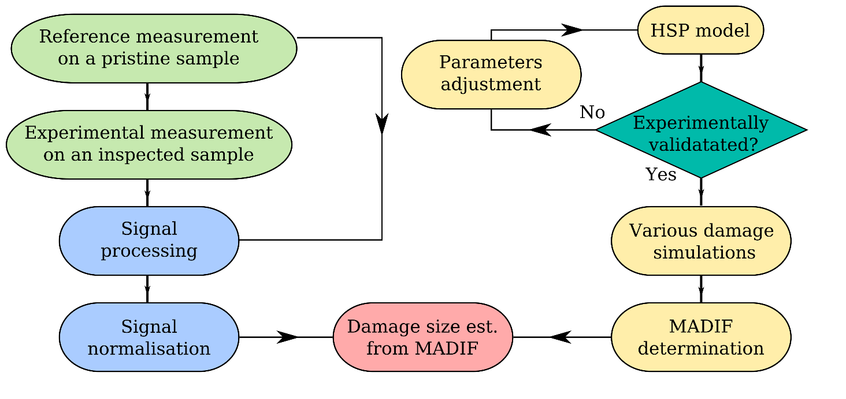
Concept of the method
Notes:
This is a diagram showing the concept of our method leading to the determination of size in the HSP panel. The model is subjected to experimental validation. Then a series of simulations are carried out for different damage sizes, based on which the model assisted damage identification function (MADIF) is obtained.

Slide 8
Development of the HSP Model

Slide 9
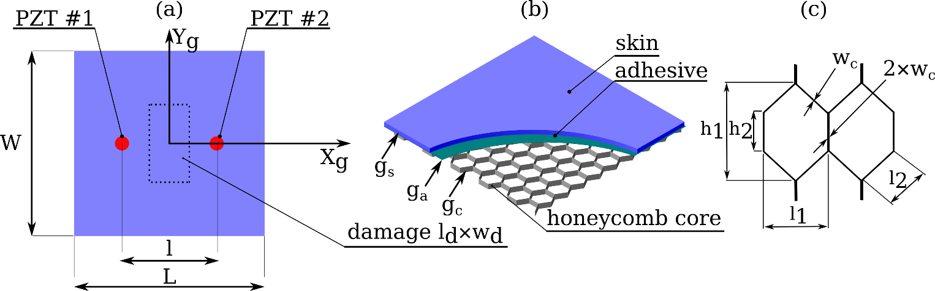
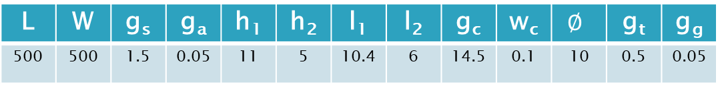
HSP sample configuration
Geometry of HSP [mm]
L | W | g_{s} | g_{a} | h₁ | h₂ | l₁ | l₂ | g_{c} | w_{c} | $$∅$$ | g_{t} | g_{g}
500 | 500 | 1.5 | 0.05 | 11 | 5 | 10.4 | 6 | 14.5 | 0.1 | 10 | 0.5 | 0.05
Top view of HSP
Panel components
Honeycomb cell

Slide 10
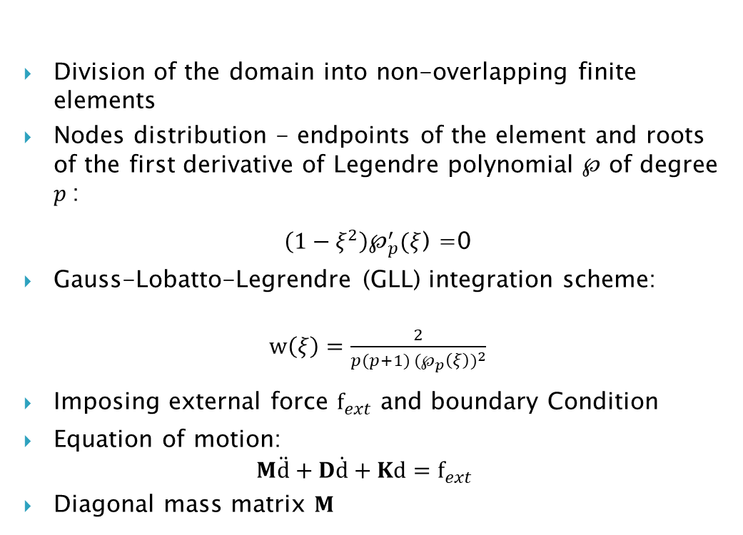
Basis of the spectral element method
Division of the domain into non-overlapping finite elements
Nodes distribution - endpoints of the element and roots of the first derivative of Legendre polynomial $℘$ of degree $p$:
$\left(1−ξ^{2}\right)℘_{p}^{′}(ξ$) =0
Gauss-Lobatto-Legrendre (GLL) integration scheme:
$w\left(ξ\right)=\frac{2}{p(p+1) {(℘_{p}\left(ξ\right))}^{2}}$
Imposing external force $f_{ext}$ and boundary Condition
Equation of motion:
$$M\ddot{d}+D\dot{d}+Kd=f_{ext}$$
Diagonal mass matrix $M$

Slide 11
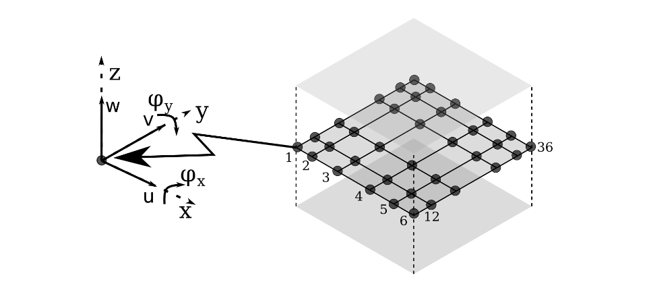
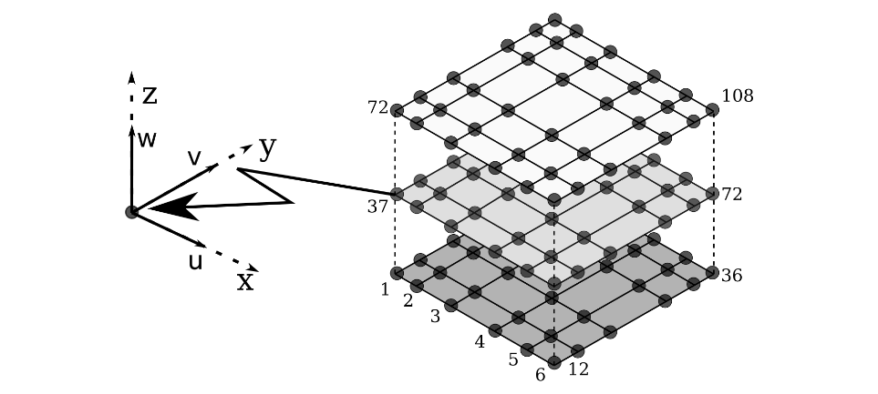
The full core geometry model (FCGM)
2D spectral elements | 3D spectral elements
Core Adhesive | Skin PZT

Slide 12
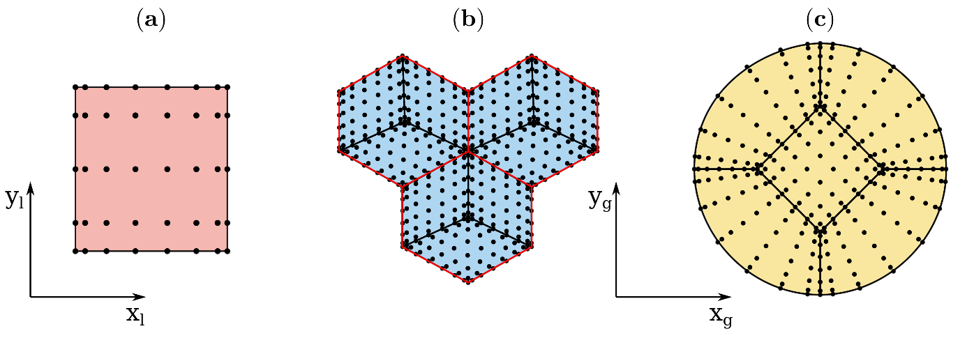
Spectral elements for panel components
The mesh with the nodes distribution, (a) spectral element used for modeling the wall of the core, (b) excerpt of the skin plate and (c) mesh for the glue under PZT with the second-order curve at the boundary

Slide 13
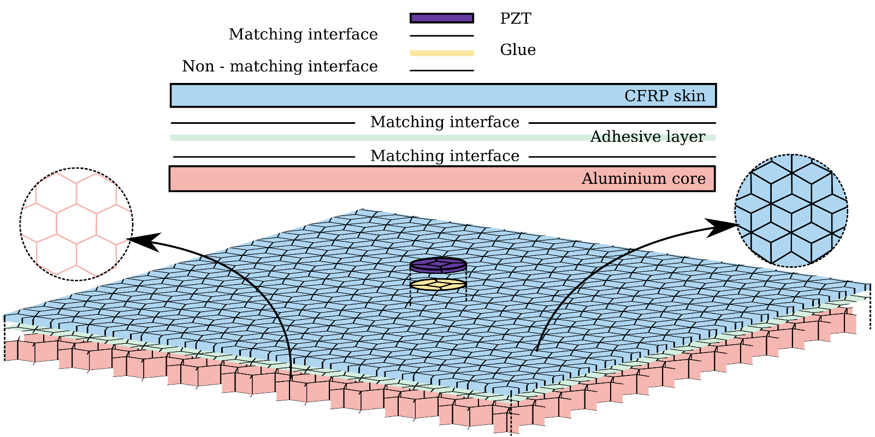
Meshes for the components with the interfaces

Slide 14
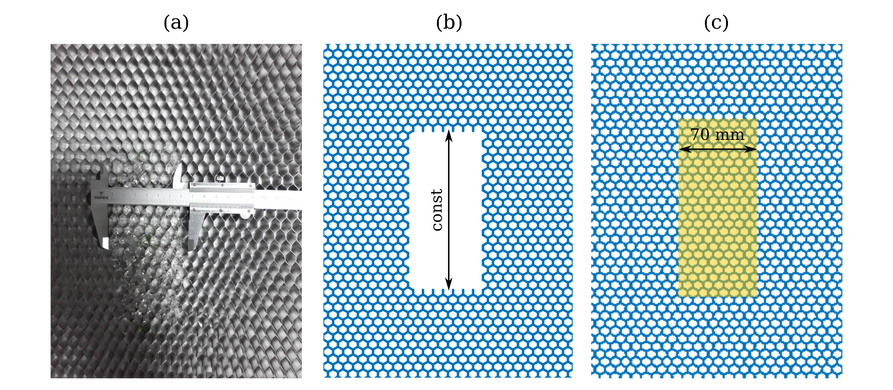
Damage models
The damaged area in the:
(a) experimental sample,
(b) numerical model with removed cells,
(c) numerical model with interface decoupling
Damage width range of 0-120 mm

Slide 15
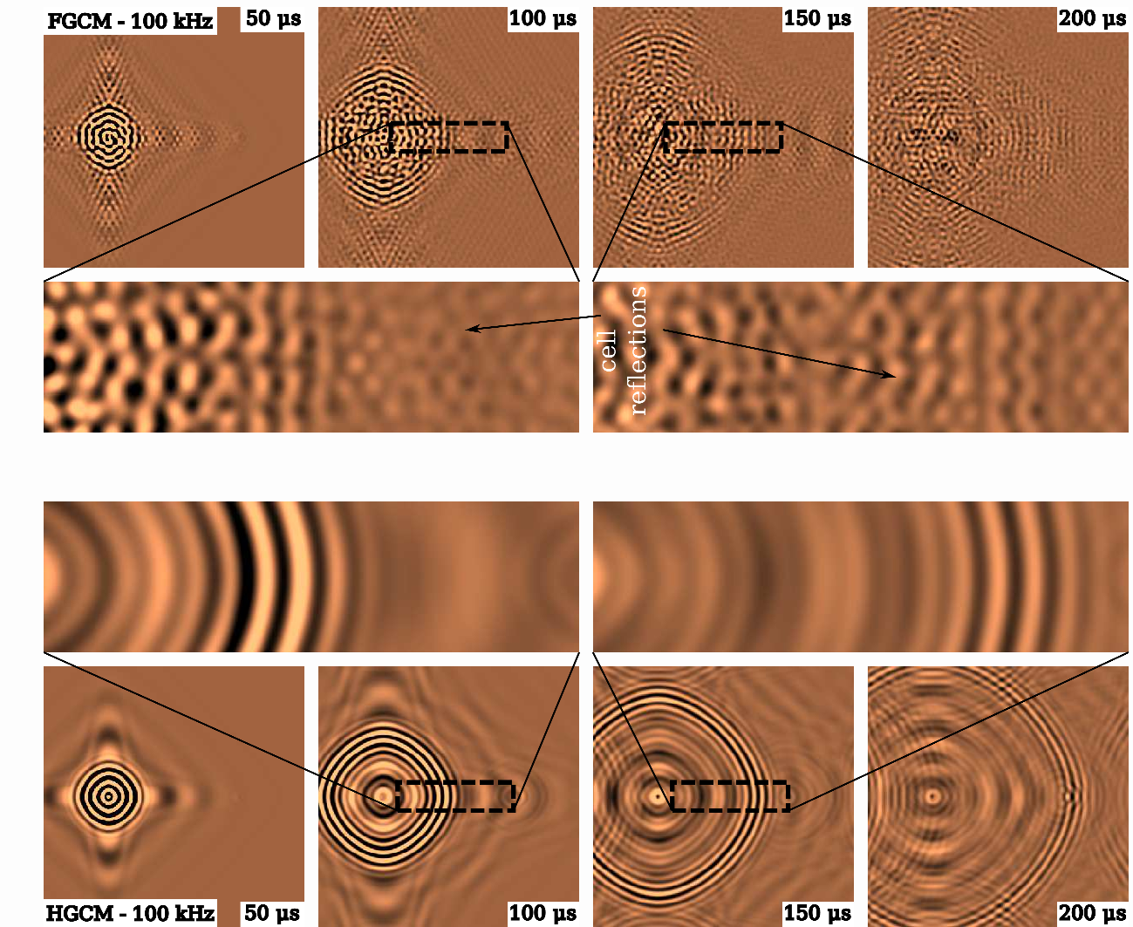
Models comparison
Present model
Homogenized
model
Full-field wave snapshots – healthy state

Slide 16
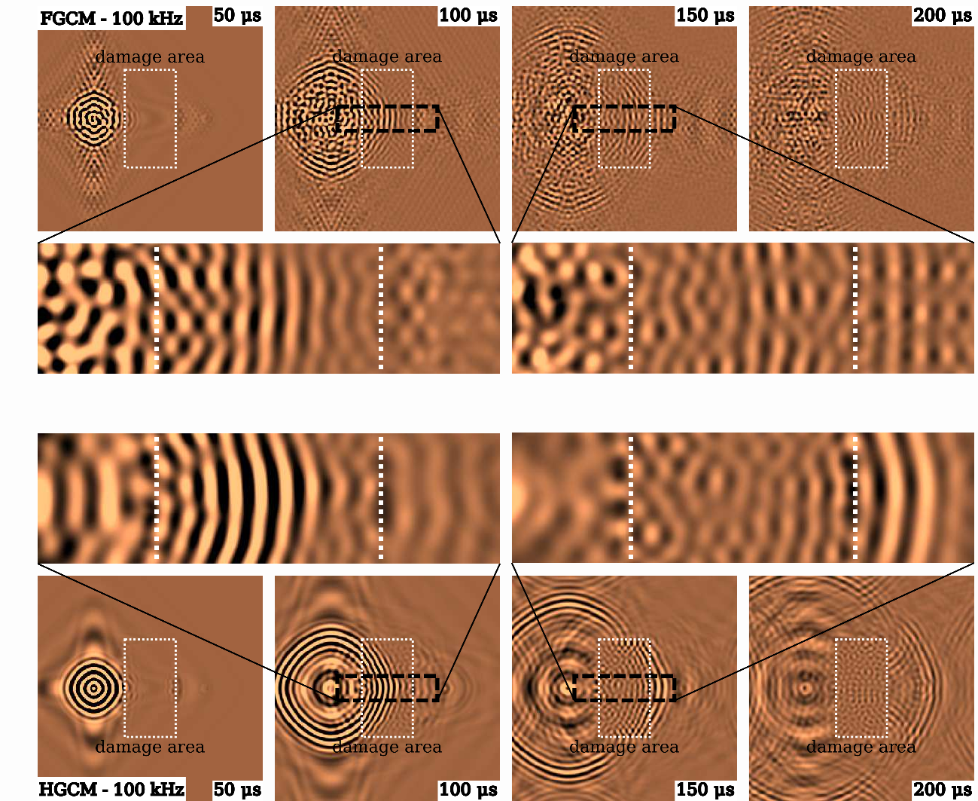
Models comparison
Present model
Homogenized
model
Full-field wave snapshots – damage 90 mm

Slide 17
Experimental Validation of the Method

Slide 18
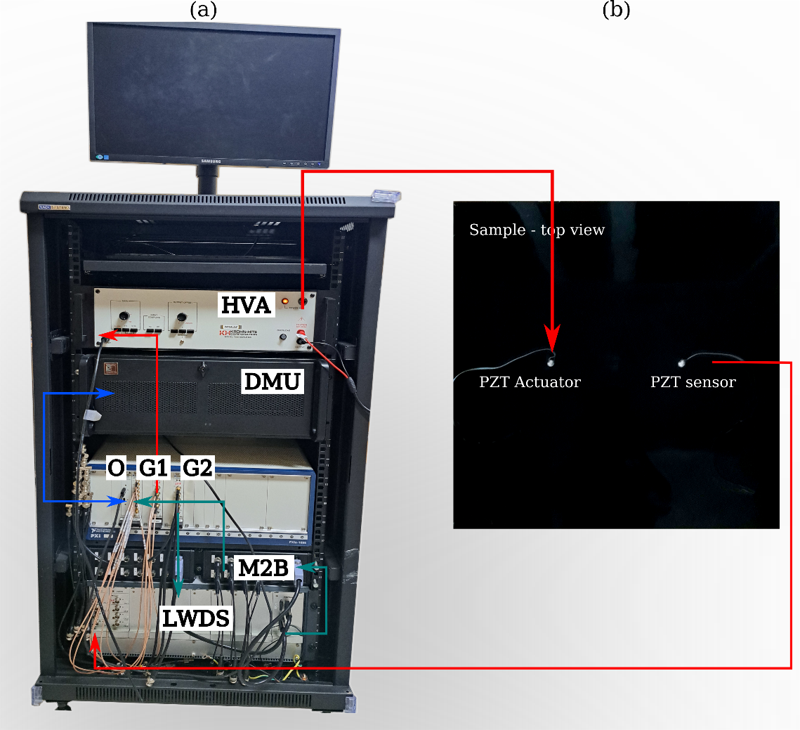
Experimental validation setup
the wave generation/acquisition setup: DMU - the data management unit,
G1, G2 - the arbitrary wave generator, O - the oscilloscope, HVA - the voltage amplifier,
LWDS - the Lamb Wave Detection Systems, (b) the specimen with PZTs

Slide 19
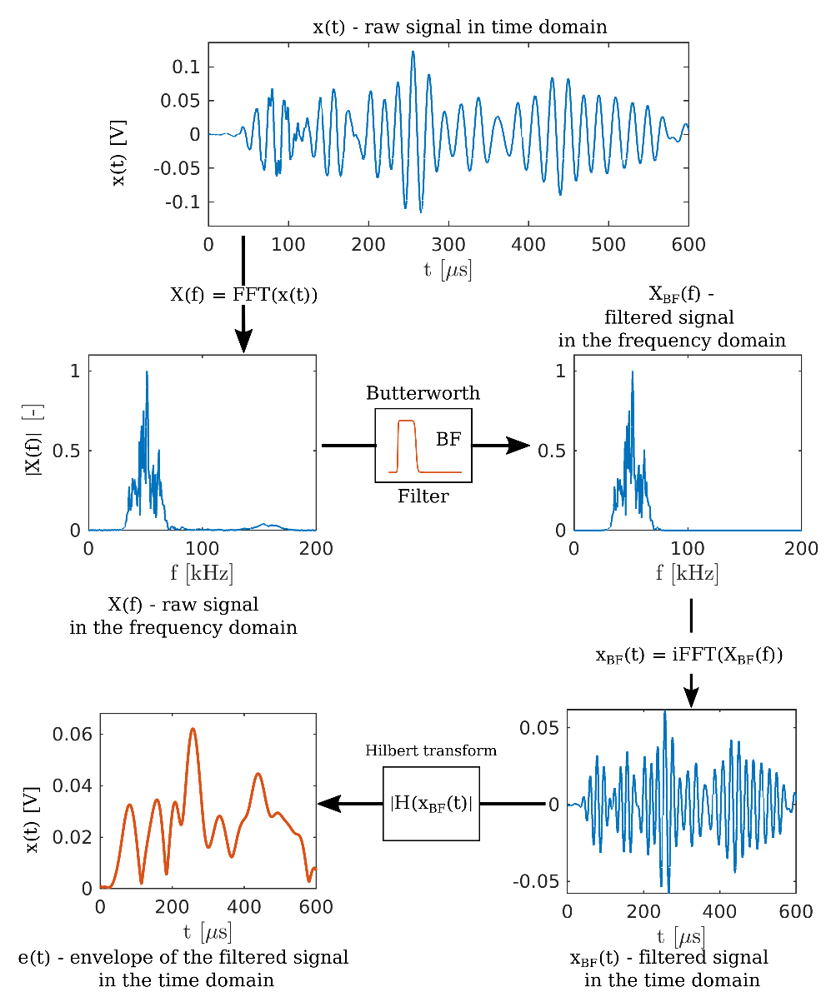
Signal processing

Slide 20
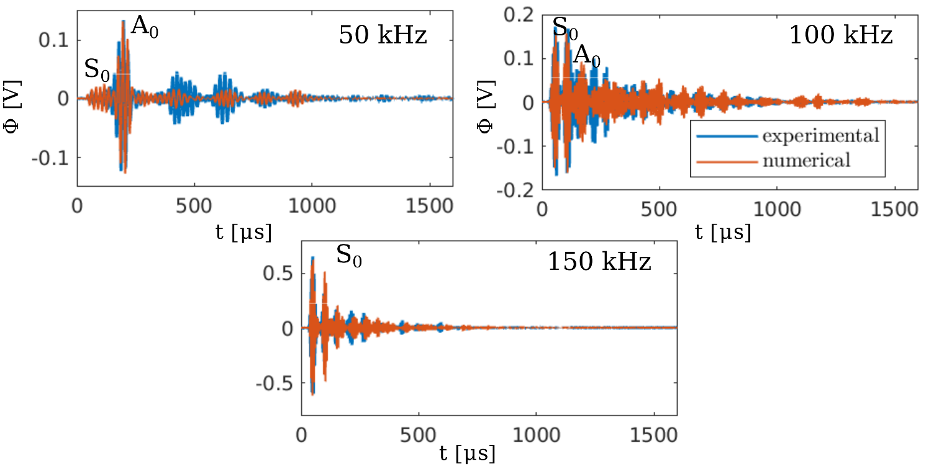
Experimental validation results - single skin plate

Slide 21
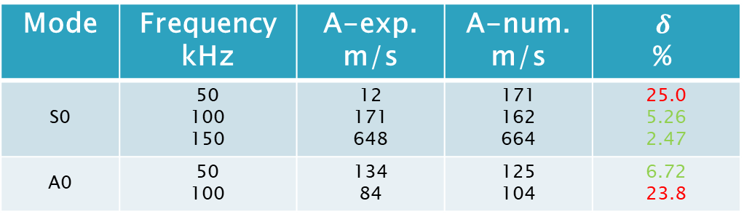
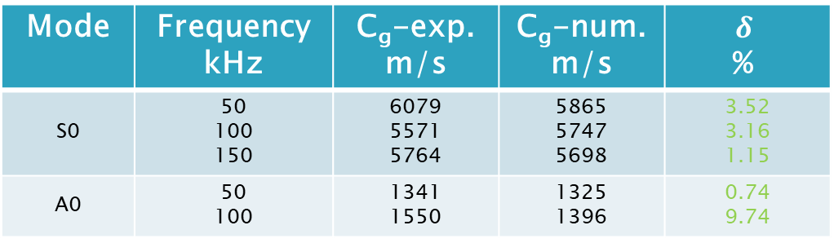
Experimental validation results - single skin plate
Mode group velocity
Mode | Frequency kHz | C_{g}-exp. m/s | C_{g}-num. m/s | $$δ$$ %
S0 | 50 100 150 | 6079 5571 5764 | 5865 5747 5698 | 3.52 3.16 1.15
A0 | 50 100 | 1341 1550 | 1325 1396 | 0.74 9.74
Mode amplitude
Mode | Frequency kHz | A-exp. m/s | A-num. m/s | $$δ$$ %
S0 | 50 100 150 | 12 171 648 | 171 162 664 | 25.0 5.26 2.47
A0 | 50 100 | 134 84 | 125 104 | 6.72 23.8

Slide 22
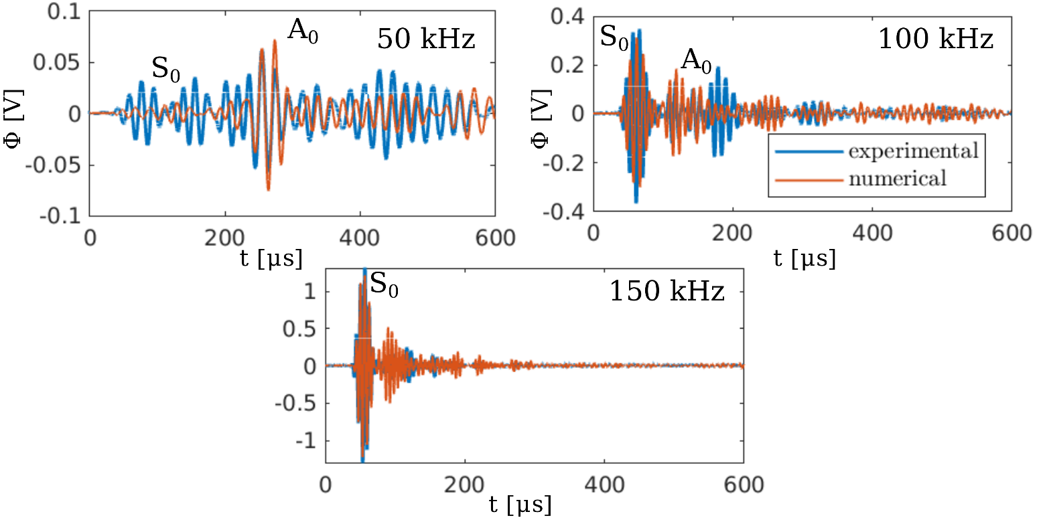
Experimental validation results - HSP based on the full core geometry model (FCGM)

Slide 23
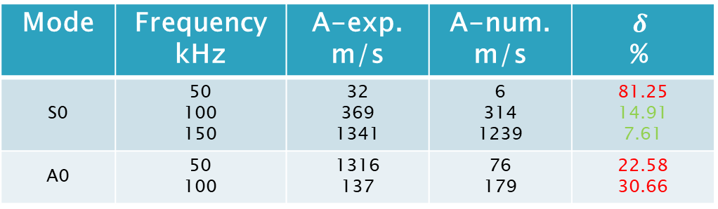
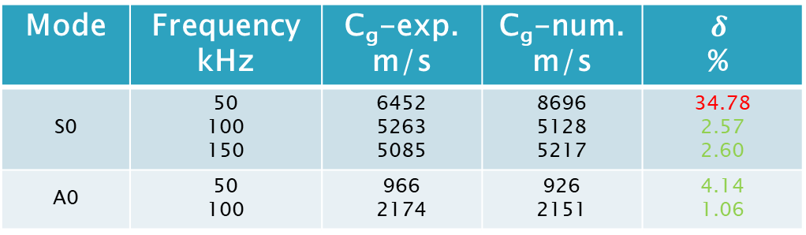
Experimental validation results - HSP
Mode group velocity
Mode | Frequency kHz | C_{g}-exp. m/s | C_{g}-num. m/s | $$δ$$ %
S0 | 50 100 150 | 6452 5263 5085 | 8696 5128 5217 | 34.78 2.57 2.60
A0 | 50 100 | 966 2174 | 926 2151 | 4.14 1.06
Mode amplitude
Mode | Frequency kHz | A-exp. m/s | A-num. m/s | $$δ$$ %
S0 | 50 100 150 | 32 369 1341 | 6 314 1239 | 81.25 14.91 7.61
A0 | 50 100 | 1316 137 | 76 179 | 22.58 30.66

Slide 24
Model-assisted Damage Identification Function

Slide 25
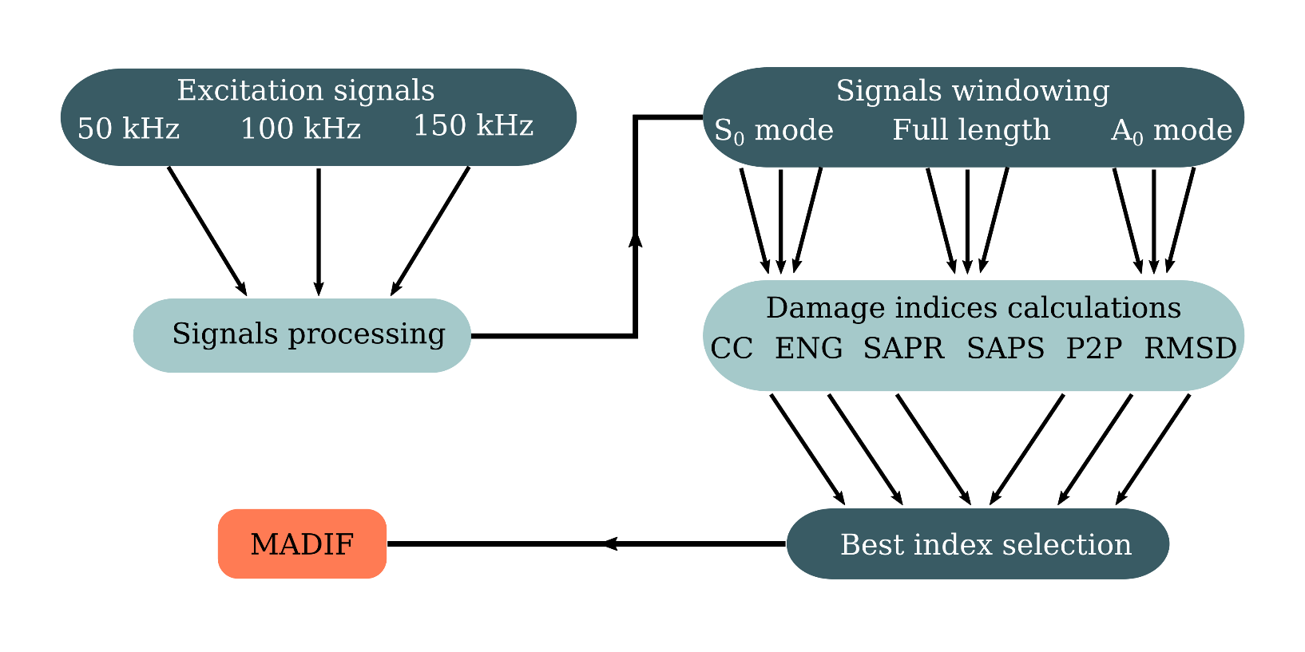
Model-assisted damage identification function (MADIF)

Slide 26
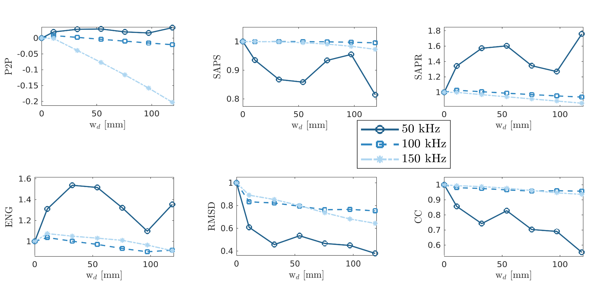
Damage indices (DI) - full length signals

Slide 27
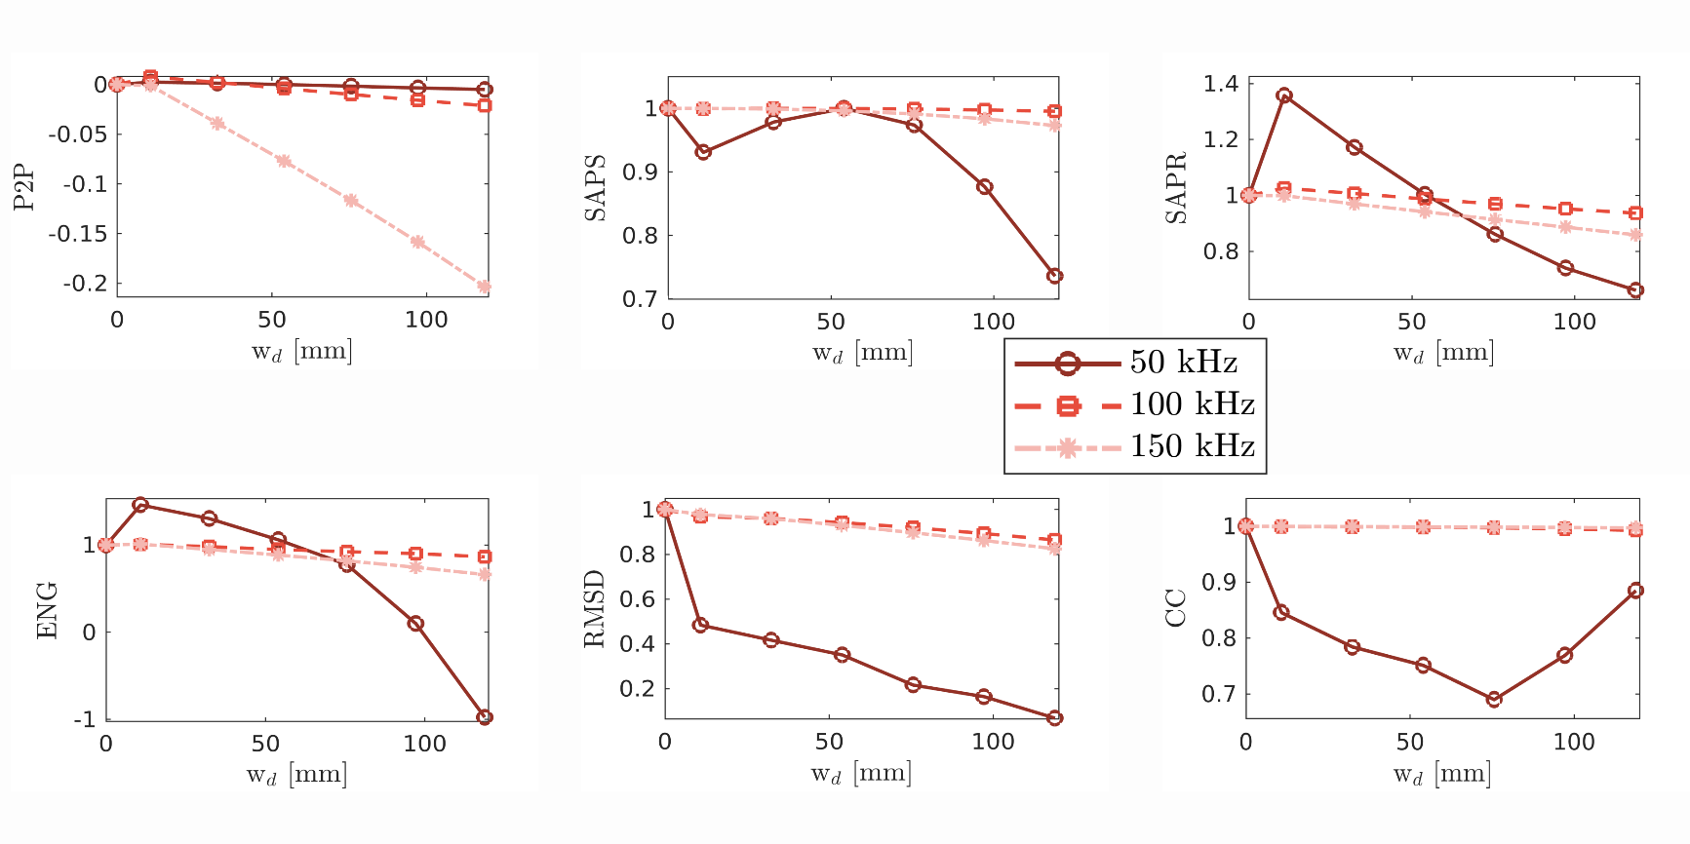
Damage indices (DI) – S₀ mode

Slide 28
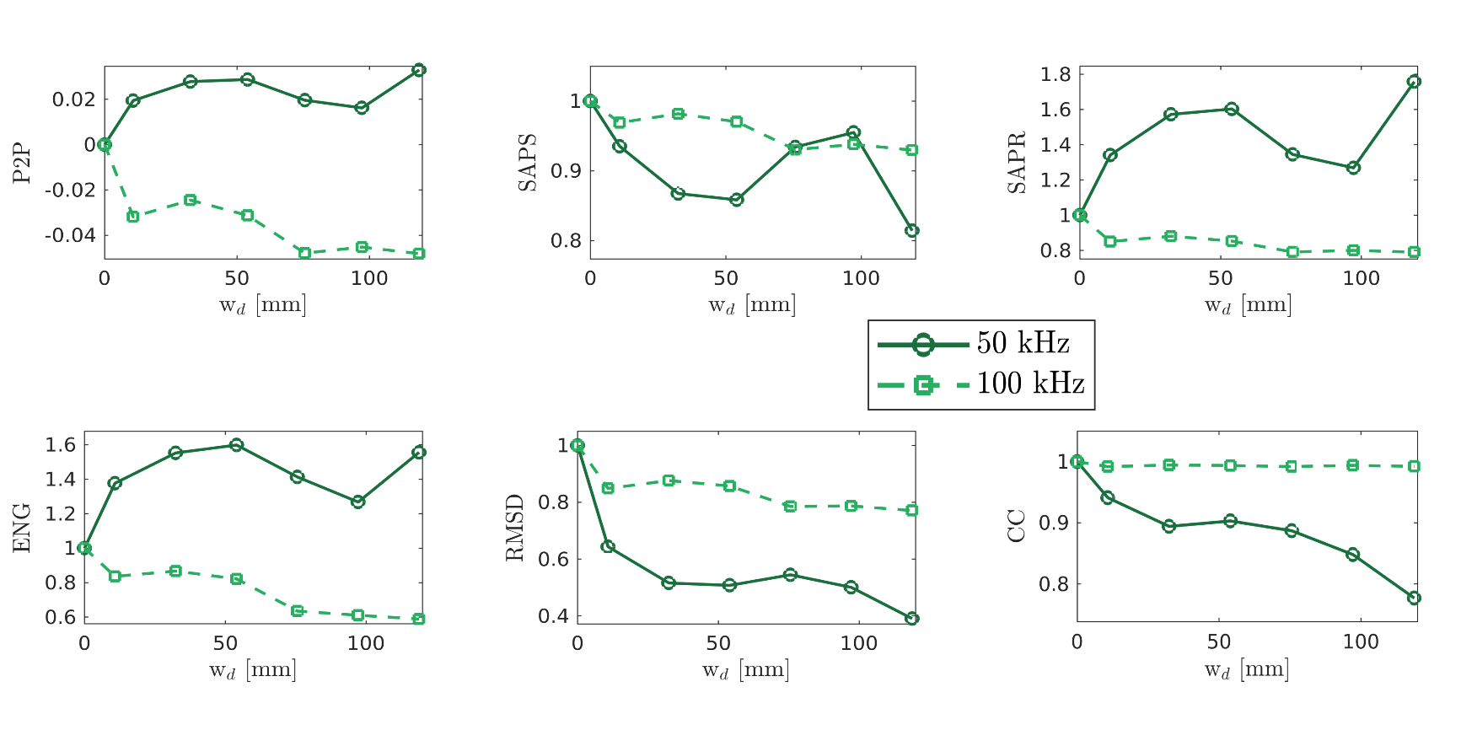
Damage indices (DI) – A₀ mode

Slide 29
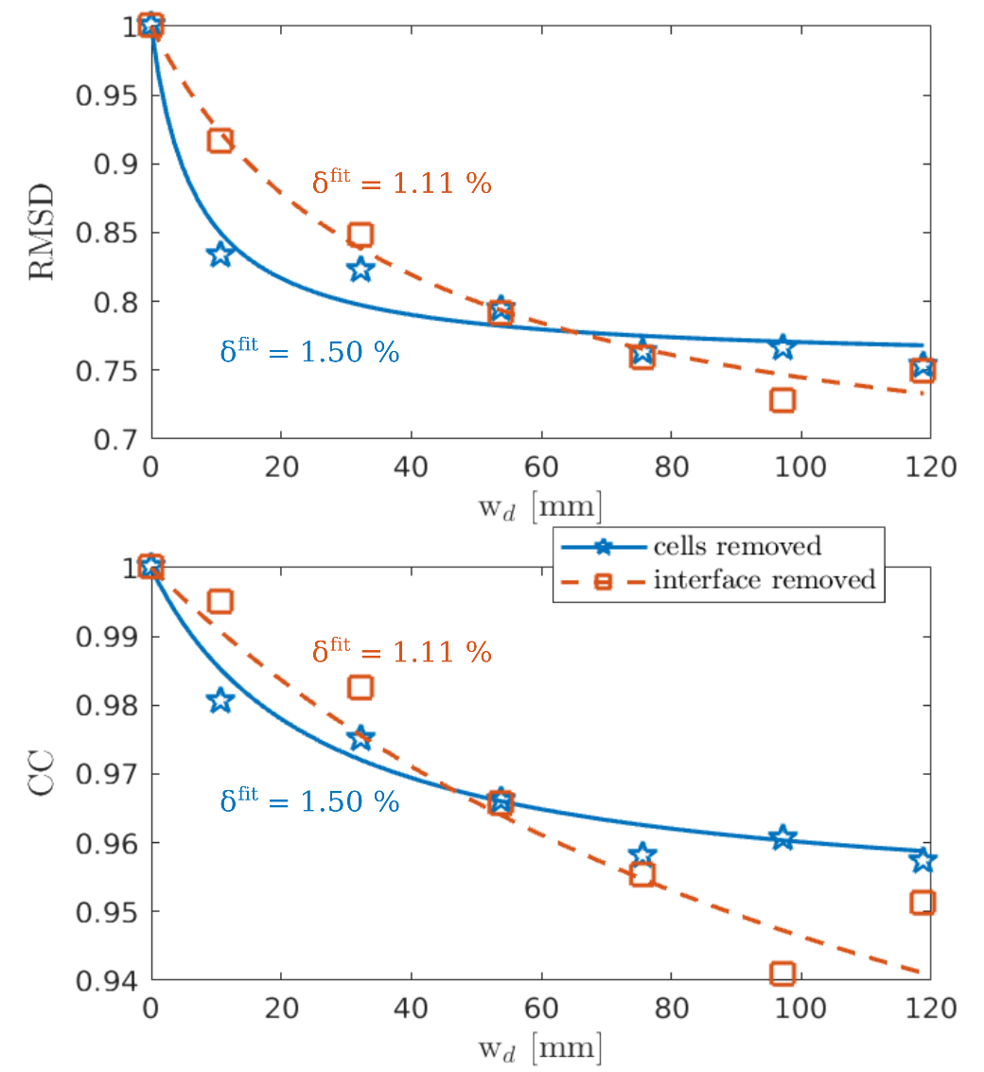

MADIF determination - full length 100 kHz signal
MADIF determination
Fitting function $$f_{1}\left(x\right)=\frac{a_{2}x}{(x+a_{1})}+a_{0}$$ $$f_{2}\left(x\right)=a_{2}\sqrt{x}+a_{1}x+a_{0}$$ $$f_{3}=\frac{a_{3}x}{\sqrt{a_{2}x^{2}+a_{1}}}+a_{0}$$
Mean absolute error $$δ^{fit}=\frac{1}{n^{DI}}\sum_{i=1}^{n^{DI}}{\left|\frac{{DI}_{n}^{i}−f(x_{d}^{i})}{{DI}_{n}^{i}}\right|}×100\%$$

Slide 30
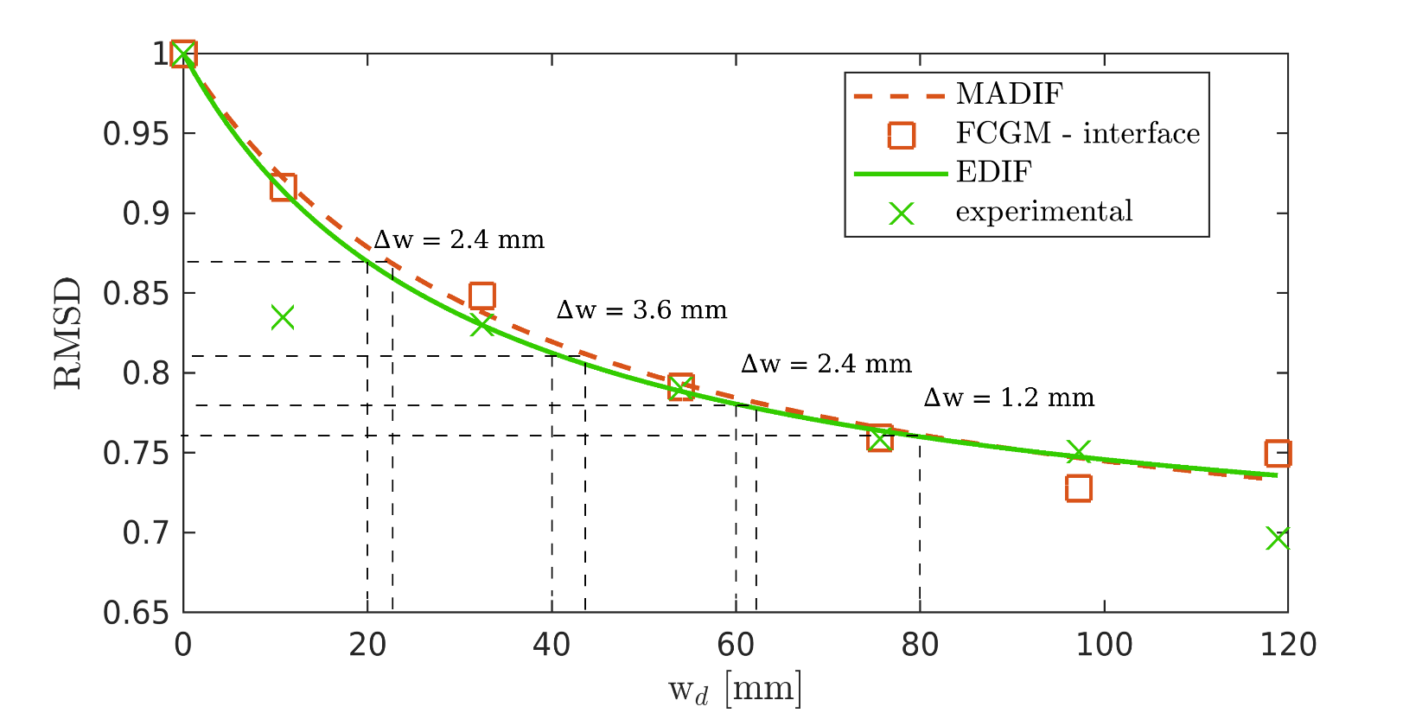
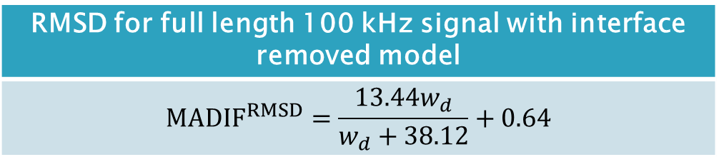
MADIF vs. experimental results
RMSD for full length 100 kHz signal with interface removed model
$${MADIF}^{RMSD}=\frac{13.44w_{d}}{w_{d}+38.12}+0.64$$

Slide 31
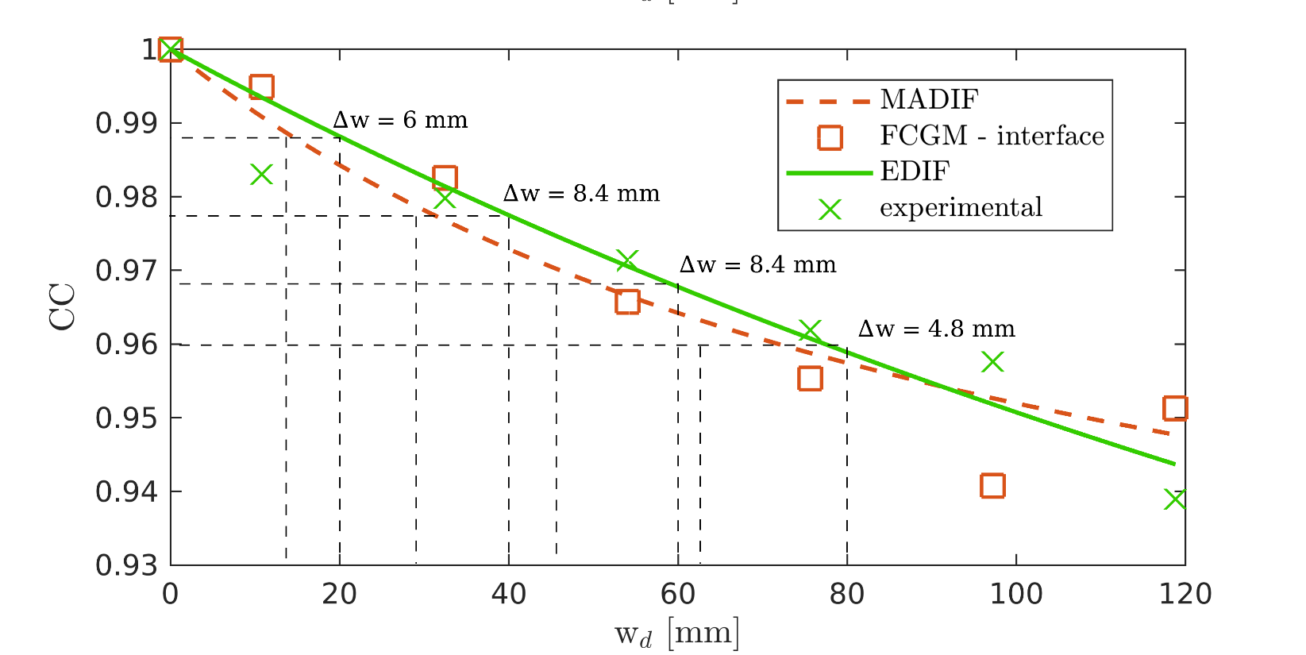
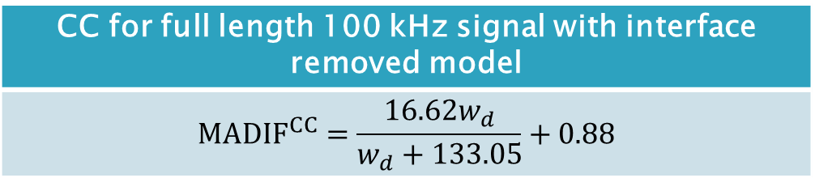
MADIF vs. experimental results
CC for full length 100 kHz signal with interface removed model
$${MADIF}^{CC}=\frac{16.62w_{d}}{w_{d}+133.05}+0.88$$

Slide 32
Final Remarks

Slide 33
Summary
Conclusions
development of the full core geometry model based on the spectral element method determination of the model-assisted damage identification function for honeycomb sandwich panel excellent agreement of the MADIF with the experimental results
Future works
temperature-dependent study on the MADIF for honeycomb sandwich composite analyzing the functions for damage with different shapes and various localization develop HSP material properties optimization tool

Slide 34

Thank you for your attention!
Acknowledgement
Author would like to gratefully acknowledge the support given by the National Science, Poland under agreement no. 2018/31/N/ST8/02865 in the frame of PRELUDIUM project entitled: 'Model-assisted damage identification function for Structural Health Monitoring of composite structures under a varied environmental condition’.

